Slide 1

North Carolina Military Affairs Commission (NCMAC) Update Brief

Slide 2
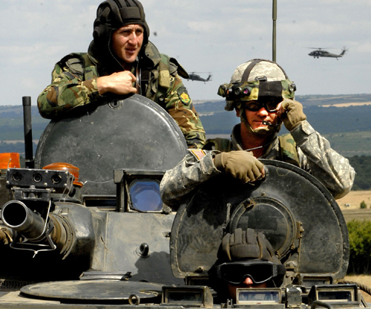
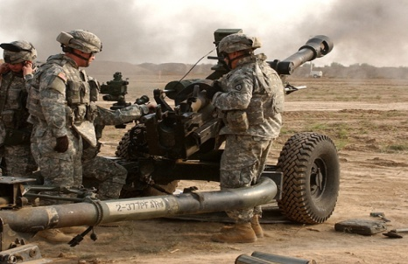
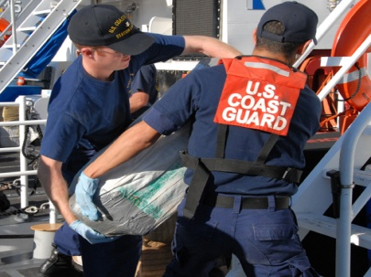
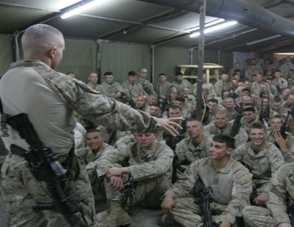
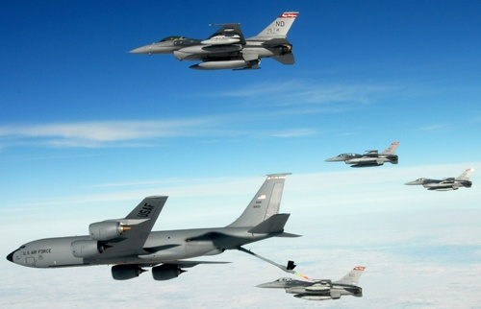
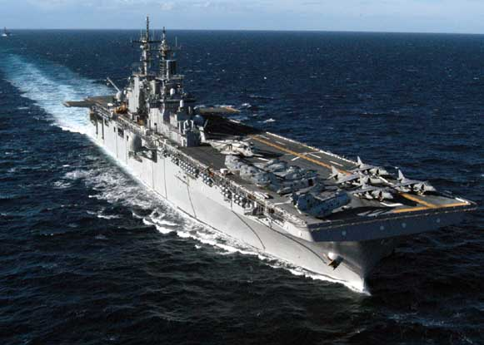
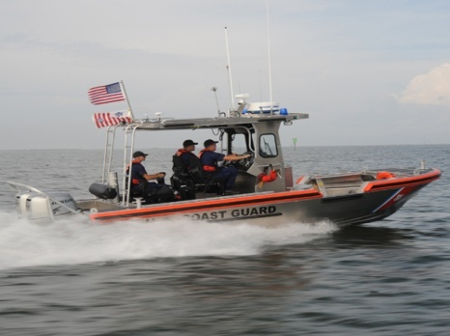
Goal for NC – be the most military friendly state in the country
Approach - Working together in partnership to strengthen NC’s military presence and economic impact

Slide 3
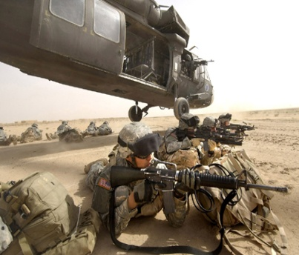
NCMAC PURPOSE:
To advise the Governor, NC General Assembly, and State agencies on ways to:
1. Protect the existing military infrastructure in NC – against incompatible development, future military budget cuts, downsizing or consolidation, future base Realignment & Closure (BRAC)
2. Promote new military missions – supporting the vitality, prosperity and expansion of our military operations
3. Improve quality of life – for military members and families by protecting and enhancing military programs and benefits.
4. Support Economic Opportunities for the State- leveraging opportunities for NC businesses and growing our economy

Slide 4
Committees
4 Standing and 1 Select:
  Sustainability & Community Affairs (Chair, Sonny Roberts)
  Economic Development (Chair, Gary McKissock)
  Quality of Life (Chair, Robert Anderson)
  Legislative Affairs (Chair, Senator Harry Brown)
  BRAC (as required) (Chair, Paul Dordal)

Slide 5
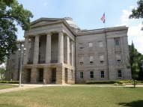

Slide 6
NCMAC Top Ten (10) Priorities
In state tuition for Military Veterans and Dependents
  Assigned to: Legislative Affairs; coordination with Economic Dev
  Status and action: One bill in the NC Senate and one in the NC House; Also additional language in the Base Budget Appropriations Bill that would extend the yellow ribbon program (Likely action would come from Budget Bill)
Reduce risk for NC Military Installations from downsizing or closures. Assess military value, develop strategic plan and engage with key decision makers.
  Assigned to: BRAC Committee.
  Status and action: 1) BRAC SWOT analysis and Strategic plan contract is waiting approval
  2) NCMAC and Military Affairs Section of Governor's Offices continues immediate actions and engagements at the Federal Level
  3) Senate Bill 614 allows State to protect documents and strategy for future BRAC from public access
  Other Information: II MEF shall remain at Camp Lejeune, Temporary Halt on movement of 440th Air Lift Wing from Pope AAF

Slide 7
NCMAC Top Ten (10) Priorities
3. Improve High Structures/Wind turbine farm legislation that affect Military Installations, Training, or Operations
  Assigned to: Legislative Affairs; coordination with Base Sustainability
  Status and action: 1) Senate Bill 614 strengthens the review process for tall structures and incompatible development, by making State Construction Office the reviewing authority
  2) Coordinating on a state map with military restrictions / requirements / airspace to assist with zoning and development.
4. Hoffman Forest training area
  Assigned to: Base Sustainability Committee
  Status and action: Working with MCI-East. Sell is not yet complete, Governor McCrory sent letter to prospective new owners requesting cooperation with DoD to preserve ability to train on lands.

Slide 8
NCMAC Top Ten (10) Priorities
5. Obtain funding for Access Control Points / failing road infrastructure on Installations
  Assigned to: Base Sustainability Committee w/NCDOT coordination
  Status and action: Working with NCDOT on top priorities for each installation, legal issues and potential partnerships.
6. Integrate Veterans, Guard, Reserve, and military dependents into NC workforce
  Assigned to: Economic Development Committee
  Status and action: 1) S761 Signed into law on July 10, 2014 – Ensure credit for Military Education and Training is recognized for Licenses and Certifications
  2) Veterans Working Group currently has lead on this issue. Focusing efforts on better means to assist Veterans in locating available employment within their qualification, and educating Employers on the skills Veterans have and how best to recruit and hire Veterans.

Slide 9
NCMAC Top Ten (10) Priorities
7. Assist NC Working Lands Group with efforts to preserve land near military installations
  Assigned to: Base Sustainability Committee in coordination with DENR
  Status and action: 1) Working with NC Working Lands Group meeting
  2) JLUS study RFP for Seymour Johnson and Dare Bombing Range published on July 17, 2014
  3) Working on possibility of moving some endangered species from Camp Lejeune and Fort Bragg to Bear Gardens
8. Leverage Federal, State, and Local funds for National Guard Infrastructure Improvement and Veteran / Service Member Programs
  Assigned to: Legislative Affairs Committee
  Status and action: Part of the Base Budget Appropriations Bill for 2014

Slide 10
NCMAC Top Ten (10) Priorities
Coordinate for state funding and support for 911 Call Centers on military installations and establish Joint 911 Call Centers with local communities where appropriate
Assigned to: Quality of Life Committee
  Status and action: City of Jacksonville and Camp Lejeune working potential solution by making installation the Back-up and Secondary PSAP (awaiting outcome)
10. Prepare NCMAC report for Governor and NC General Assembly.
  Assigned to: Chairman, Military Affairs Advisor and ESG
  Status and action: Governor and Speaker of the House has been briefed, awaiting briefing date and time for Senate Pro Tem.

Slide 11
Summary
The NCMAC is operational and meeting the goals and requirements as defined in General Statue and Directives from the Governor
A strategic plan is forthcoming with short range and long range goals, in the meantime the Commission is focused on immediate requirements
The Commission is developing a systematic path with subsequent steps to achieve long range goals
All actions support our top ten priorities
All efforts work to ensure that North Carolina remains the unquestionable Friendliest State to this Nation’s Military and Veterans

Slide 12
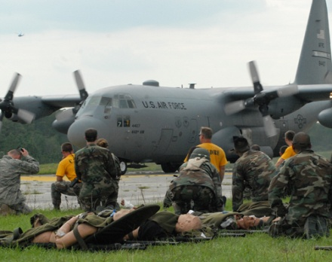
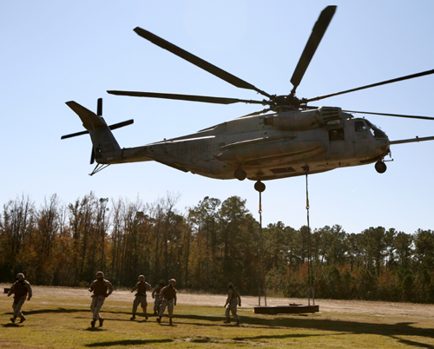
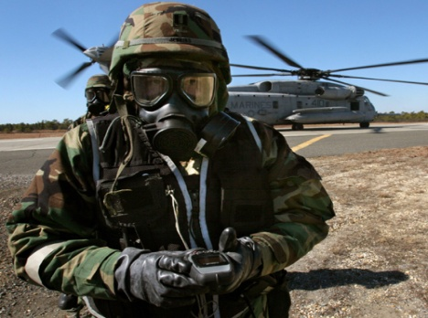
Questions?

Slide 13
Back Up SLIDES

Slide 14
Second only to Agriculture, North Carolina’s Defense Economy Quietly Impacts Businesses Across the State
Total Annual Military Impact
10% of NC’s economic activity – NC’s second largest sector of the economy
Nearly $30B comes to NC from the US Department of Defense
$30B in Personal Income, $48B in Gross State Product
Defense contracts in FY2012 :
  Prime contracts: $3.43 billion
  Subcontracts: additional billions*
Prime Contracts in NC: federal (100 Counties); DoD (83 Counties):
DoD Prime Contracts in NC,
By Type (FY2012)
* Data for subcontracting unavailable

Slide 15
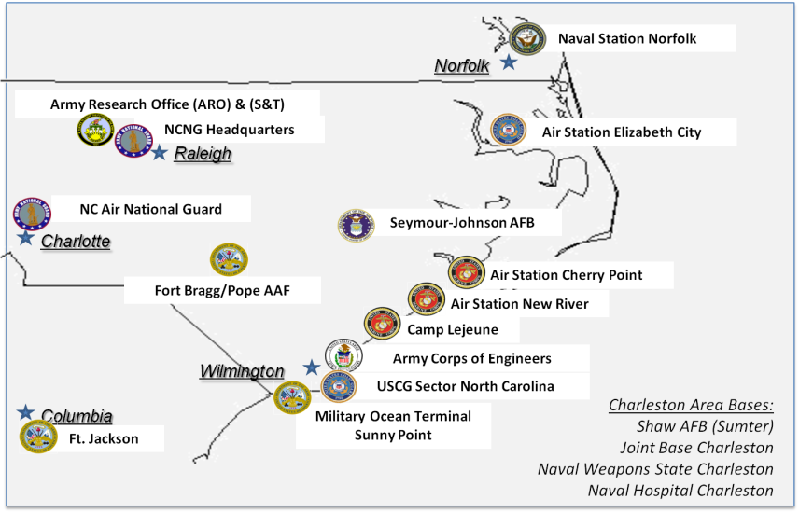
North Carolina’s Military Presence is Unrivaled and has a Dramatic Impact on our State’s Security, Economy, and our Way of Life
3rd highest active duty military presence
6 major installations (5 DoD/1 DHS)
  116 NC National Guard facilities
  40 Army Reserve facilities statewide
  139,000 Active, Guard and Reserve personnel
    Over 50% of Special Operations Forces

Slide 16
  NC Veteran Population
  Over 769,000 Veterans across the state (12% of the state population)
  Veterans represent a large and skilled labor pool
  225,000 veterans less than 50 years old
  An Additional 83,000 Military Retirees reside in NC
  8,000 annual transitions in NC
  35% of NC population are either military, veteran, spouse, parent, or dependent

Slide 17
Department Military Awareness Coordinators
Department | Name | Email Address | Phone
Cultural Resources | Mark Cooney | mark.cooney@ncdcr.gov | 919-807-7473
Health and Human Resources | Jason Simmons | jason.simmons@dhhs.nc.gov | 919-855-4800
Commerce | Anna Lea Moore | alea@nccommerce.com | 919-715-7226
Public Safety | William Crews | bill.a.crews@ncdps.gov | 919-716-3800
Revenue | Daryl K. Morrison | Daryl.Morrison@dornc.com | 919-814-1117
Administration | Ilario Pantano | Ilario.Pantano@doa.nc.gov | 919-807-4250
Transportation | Sebastian Montagne | smontagne1@ncdot.gov | 919-707-0954
Environmental and Natural Resources | Bryan Gossage | bryan.gossage@ncdenr.gov | 919-707-8620
Note: Executive Order #34 requires the Secretary of each Cabinet Agency shall designate a Military Affairs Awareness Coordinator

Slide 18
At Large Delegates
(Committee assignments)
Brigadier General Mabry “Bud” Martin, ARNGUS Retired: Commission Chair
Brigadier General Paul Dordal, USAF Retired: Sustainability, BRAC (Chair), & Commission Vice Chair
Joy Thrash: Economic Development & Community Coordinator for Fort Bragg
Joshua L. Glover: Economic Development
John C. Matthews: Quality of Life
Cindi Basenspiler: Quality of Life

Slide 19
Fort Bragg Area Delegates
(Committee assignments)
General Dan McNeill, USA Retired: Economic Development & BRAC
Lieutenant Colonel Robert Anderson, USA Retired: Quality of Life (Chair)
George Breece: Quality of Life
Mayor Tony Chavonne (ex officio): Sustainability
Senator Wesley Meredith (ex officio): Legislative Affairs

Slide 20
Camp Lejuene & New River MCAS Area Delegates
(Committee assignments)
**Major General Bob Dickerson, USMC Retired: Sustainability & BRAC
Lieutenant General Gary McKissock, USMC Retired: Econ. Dev. (Chair) & BRAC
Sergeant Major Bill Hatcher, USMC Retired: Legislative Affairs
Senator Harry Brown: Legislative Affairs (Chair) & BRAC
Rep. George Cleveland: Legislative Affairs
Mayor Sammy Phillips (ex officio): Sustainability
  ** Community Coordinator

Slide 21
Cherry Point MCAS Area Delegates
(Committee assignments)
**Colonel Frank Bottorff , USMC Retired: Sustainability & BRAC
Sonny Roberts: Sustainability (Chair)
Creswell Elmore: Economic Development
Mayor Will Lewis (ex officio): Sustainability
  ** Community Coordinator

Slide 22
Seymour Johnson AFB Area Delegates
(Committee assignments)
Mr. Jeremiah Daniels: Legislative Affairs
**Colonel Joe Marm, Jr., USAF Retired: Sustainability
Honorable Efton Sager: Legislative Affairs
Mayor Al King (ex officio): Sustainability
Rep. John Bell: Legislative Affairs
  ** Community Coordinator

Slide 23
Elizabeth City US Coast Guard Area Delegates
(Committee assignments)
Commander Bill Lehman, USCG Retired: Quality of Life
Mayor Joe Peel (ex officio): Sustainability
  ** Community Coordinator

Slide 24
NCMAC Legislative Best Practice Review
Facilitate service member receiving licensure and academic credit for military education, training, and experience.
Facilitate military spouse transition through licensure portability and eligibility for unemployment compensation.
Support development of veterans treatment courts open to eligible veterans and service members throughout the state.
Increase access to quality, affordable childcare for military families.
Promote consumer protections and enforcement of the predatory lending regulation.

Slide 25
NCMAC Legislative Best Practice Review
6. Allow service members to retain their earned priority for receiving Medicaid home and community care waivers.
7. Improve absentee voting for military members and their families.
Waive required waiting time to establish residency for separating service members to obtain in-state tuition rate.
Assign an identifier for military children in education data systems.
Create state-wide MOUs between the DoD and the state child welfare agency to standardize relationships.

Slide 26
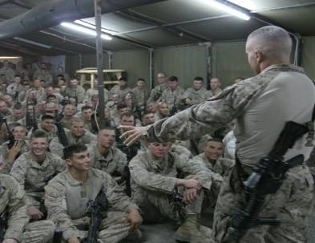
Functions of the Commission
NC “Clearing House” for military related issues in NC
Directly assist the military installations by coordinating with commanders, communities and state and federal agencies on top issues and priorities that may require State level assistance
Coordinate issues and actions with State Agencies, the NC General Assembly, and other military related organizations in NC.
Assist the NC General Assembly to evaluate proposed legislation
Lead the BRAC preparation effort for North Carolina
Support economic development initiatives, especially those with dual purpose, such as “Feed and Fuel the Forces”

Slide 27
Military Affairs Commission Process
Identify Issues, problems and opportunities
By Commanders, Commissioners, communities, educators or state agencies
Military Affairs Commission Quarterly Meetings
Committees
Frame the issue
Involve SMEs
Develop recommendations & receive Commission approval
Report to the Governor and General Assembly
State Agencies
Commander’s Council
Recommendations
Impact to the State
Options, Course of Action and Solutions
DOD Requirements
Assess potential for mission degradation
Identify impact on Military (Training, Economy, Quality of Life
Issues are presented and discussed
ESG

Slide 28
BRAC Preparation
NCMAC designated by the NC General Assembly to lead the State’s preparation for the next round of BRAC
State allocated $1 million for BRAC preparation
Coordinating BRAC preparation efforts:
  Working with regional and community organizations
  Hiring experts to assess Strengths, Weaknesses, Opportunities and Threats (SWOT) analysis of military installations
  Evaluate prior BRAC scoring and changes that could affect
  future actions
  Recommend actions to maximize opportunities and minimize losses
Recommendation for consultant firm to assist with SWOT analysis is working it ways through channels to be signed as a contract

Slide 29
NCMAC Key Accomplishments
Approved by-laws in place
All NCMAC members appointed with four (4) meetings to date
Administrative budget developed and approved
Four (4) standing committees and one select BRAC committee in place
Community coordinators appointed
Cabinet Military Affairs Awareness Coordinators identified
Military advisor and staff in place supporting NCMAC
CODEL visit by Governor with military advisor and NCMAC leadership
Military advisor and NCMAC leadership met with NC Regional Military Partners
Membership in Association of Defense Communities to identify best practices from other states and regions (attended ADC Innovation Forum in FEB ’14)
Partnering with Governor’s Chief Advocate in DC, Virginia Johnson, on Military Issues
Contractor selected to conduct SWOT analysis (awaiting final approval)

Slide 30
NCMAC Legislative Priorities
In state tuition for Service Members, Veterans, and Dependents
Refine Encroachment and Tall Structure laws to protect Military Training and Mission Requirements
Assist Installations with Road Improvements and Emergency Service Call Centers
Support NC National Guard Efforts for Infrastructure Modernization and Improvements

Slide 31
Legislative Actions for Military In-Progress
In-state tuition:
  Two Versions being worked (Governor’s Office and UNC Request), no clear answers on which one the Senate will move forward
Section 3.37 of Senate Bill 734: Military Lands Protection Act And Military Affairs Commission Amendments
  Strengthens law that ensure encroachment on Military Installations are managed to prevent degradation of training and readiness
  Moves responsibility for approving tall structure within 5 miles of an installation from the Commissioner of Insurance to the State Construction Office
Senate Bill 760 / House Bill 1048: Adjutant General Selection Criteria
  Strengthens current language to ensure the Adjutant General is capable of receiving federal recognition in the rank of Major General
Senate Bill 761: Credit for Military Training
  Provide clearer guidance to licensure and professional boards on accepting military education and training, as well as certification from other states for Military Service Members and their dependents
  Places timelines on responding to requests and ensure justification for denials are provided
Senate Bill 771 / House Bill 1060: Military Student Identifier
  Requires the State Board of Education to develop an annual identification process to identify military connected students using the Uniform Education Reporting System

